Slide 1

SCHOOL OF ELECTRICAL & COMMUNICATION
DEPARTMENT OF ELECTRONICS AND COMMUNICATION ENGINEERING
REDUCE,REUSE,RECYCLE
10214EC501
COMMUNITY SERVICE PROJECT
SUMMER SEMESTER(2023-2024)
REVIEW - II
SUPERVISED BY
Dr.PRASANNA R,
Assoc.Prof. Dept of ECE.
PRESENTED BY
1. M.Shanmukha mani (VTU.NO:20467)(REG.NO:21UEEA0077)
2. L.Pavan Kumar Reddy (VTU.NO:20456)(REG.NO:21UEEA0068)
3. P.Maruthi Ram (VTU.NO:20558)(REG.NO:21UEEC0260)

Slide 2
Agenda
ABSTRACT
OBJECTIVE
INTRODUCTION ABOUT VILLAGE
ACTIVITY LOG
SURVEY
SURVEY ANALYSIS WITH REPORT
SOCIETY RELEVANT PROBLEM IDENTIFICATION
NOVEL IDEA GENERATION
PROTOTYPE/DEVELOPMENT OF NEW SOLUTION
GEOTAGGED PHOTOS AND DETAIL&VIDEO LINK
AUTHENTICATED SIGNATURES PROOF AND DETAIL
PLAGIARISM REPORT

Slide 3
ABSTRACT
Economic development and people’s changing patterns of consumption and production have led to a drastic increase in plastic wastes all over the world.
Plastic waste disposal harms the environment and poses threat to human health.
There is a great desire to reduce the plastic wastes.
To reduce plastic wastes, education is of utmost importance as education can change people’s knowledge, attitude and behaviours towards plastic waste management.
The effectiveness of three teaching strategies can change in knowledge, attitude and behaviour in students towards plastic waste management.
For protecting the nature and explaining the importance of environment in our daily life.

Slide 4
OBJECTIVES
Aim of the Project:
“ Protecting the Environment ”
The aim is raising awareness about waste management and the importance of recycling, encourage people and students about waste management, recycling, waste segregation practices within the community.
Scope of the Project:
Exploring eco-friendly methods to decompose plastic, efficient waste collection methods, promoting recycling, and raising awareness for responsible plastic disposal in the village of Morai.

Slide 5
INTRODUCTION ABOUT VILLAGE
Morai Village is a charming rural settlement located in Thiruvallur(Avadi).
The warm and welcoming community promotes a strong sense of unity and cooperation among its residents.
The village is a haven for nature enthusiasts and photographers.
The village people prepare the dishes using local ingredients. The taste of the dishes is a delicious experience.
Dynamic festivals and celebrations bring the village to life throughout the year.
The village has ancient temples and structures showcasing its cultural background.
Local handcrafts preserve traditional arts and crafts, including handwoven textiles and pottery.
Villagers take pride in their efforts towards nature conservation and sustainability.
The close-knit community ensures a memorable and heartwarming experience for visitors.

Slide 6
ACTIVITY LOG
Day/Date | Brief Description of the daily activity | Learning Outcome
06/09/23 Friday | Visited Grama Panchayatihi office of Morai for permission | Permitted to do Service and survey in Village
07/09/23 Saturday | Visited the Streets of Morai Village | Analysed the wastage occured from House hold and Other Scopes
08/09/23 Sunday | Moved along Municipality workers in the streets of morai | We identified their problems.
10/09/23 Tuesday | Visited Local Shops in Morai. | Plastic waste is generated more shops like wine Shop,juice shop etcc..
12/09/23 Thursday | Reporting about problems in village (waste management , recycling and segregation). | Successfully data collected.

Slide 7
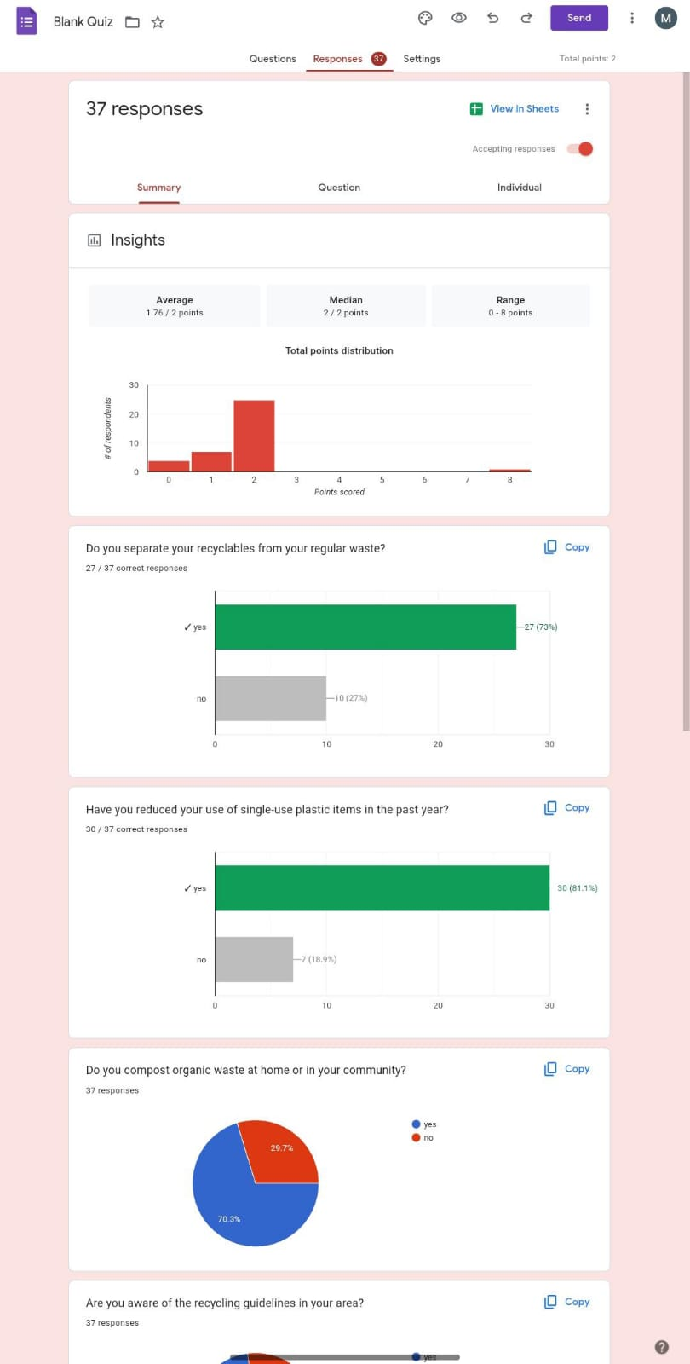
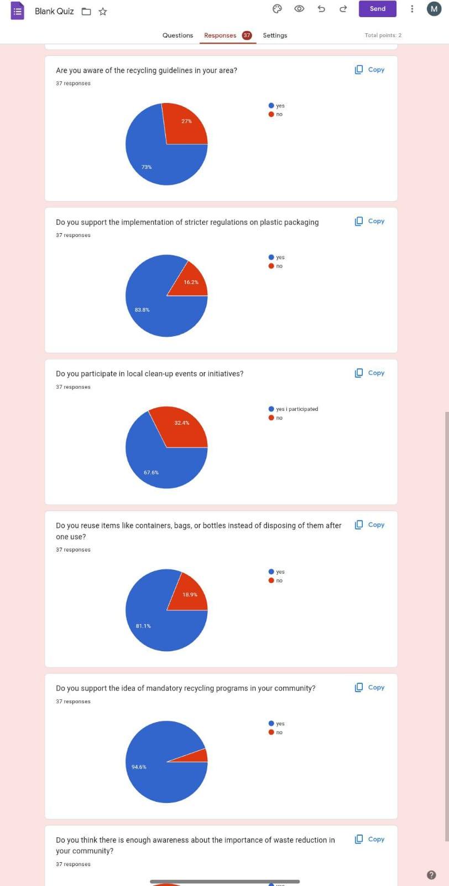
SURVEY-DETAILS
We conducted one online survey that is to know about how people will manage their household waste and how they recycle, and segregation the waste.

Slide 8
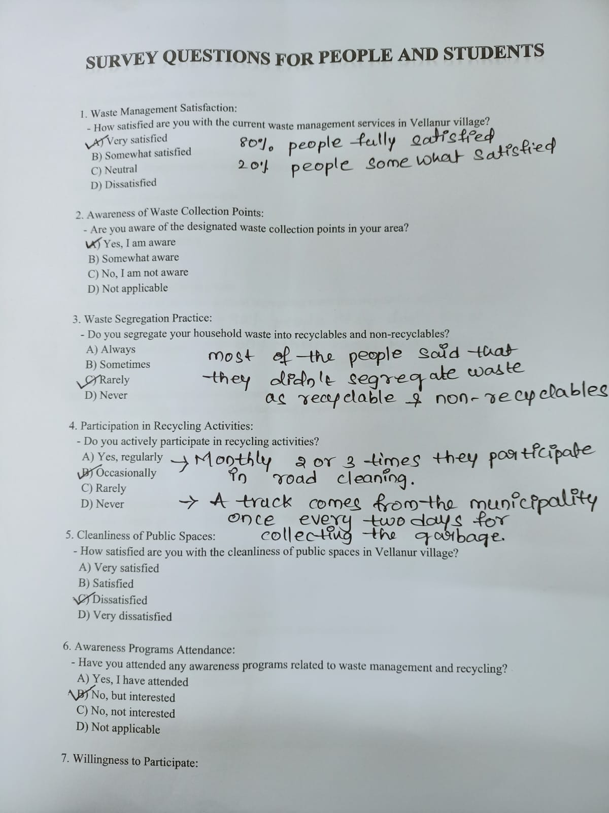
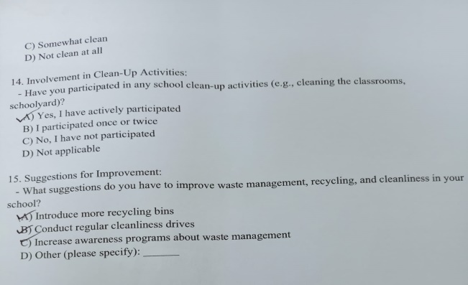
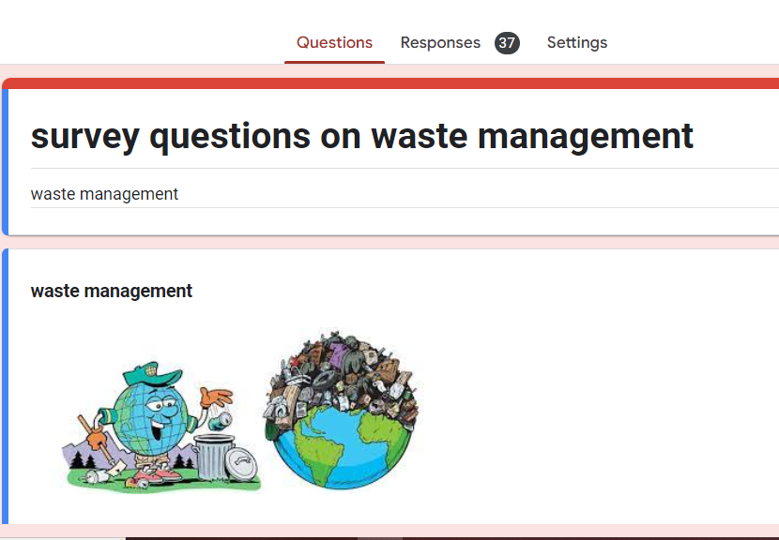
SURVEY ANALYSIS

Slide 9
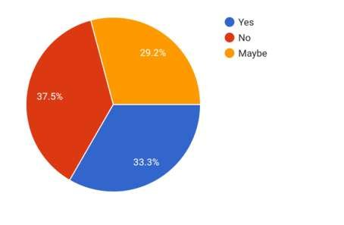
SURVEY ANALYSIS
33.3% of people aware of waste segregation, recycling, managing.
37.5%of people don’t know importance of waste management,recycling,segregation.
29.2% of people they have some knowledge about these.

Slide 10
SOCIETY RELEVANT PROBLEM IDENTIFICATION
1.IMPROPER WASTE MANAGEMENT
Improper waste management can lead to the spread of diseases through contaminated water and air, affecting public health and also animals.
2.OPEN DUMPING OF GARBAGE
Improper disposal, such as open dumping of waste in public areas, rivers can lead to pollution and health hazards.
3.LACK OF AWARENESS
People might not be aware of the importance of proper waste disposal methods. Vellanur people might lack education on reducing waste generation, reusing items, and adopting sustainable practices.
4:LOCAL SHOPS
A Wine Shop and Juice shop is located in the village.Daily more than 3-4kg of plastic is collected from those shops.totally that plastic is trasfered to a dumpy yard in village,but due to those plastic bacteria and fungus are occuring
BATCH NO:225 DEPARTMENT ELECTRONICS AND COMMUNICATION ENGINEERING

Slide 11
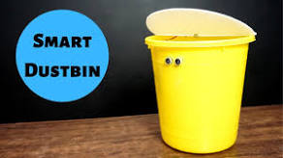
PROTOTYPE/DEVELOPMENT OF NEW SOLUTION
SMART AUTOMATIC DUSTBIN
BATCH NO:225 DEPARTMENT ELECTRONICS AND COMMUNICATION ENGINEERING
11

Slide 12
Components
Arduino Board
Ultrasonic Sensors
Servo Motor
Traditional Dustbin
Card Board
Connecting Wires

Slide 13
Working principle
Smart Dustbin works on the principle of object detection using an ultrasonic sensor. The ultrasonic sensor transmits sound waves. These waves get reflected whenever an object comes into the vicinity of the sensor. Based on the distance between the ultrasonic sensor and the object . The decision to either open the lid or measure the distance again will be decided by the arduino.
If the object is near to the sensor the arduino sends the signal to the servo motor to open the lid. If the object is far from the ultrasonic sensor. The arduino keeps measuring the distance until the object comes near to the ultrasonic sensor.

Slide 14
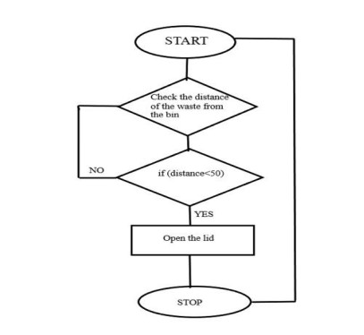
FLOW CHART

Slide 15
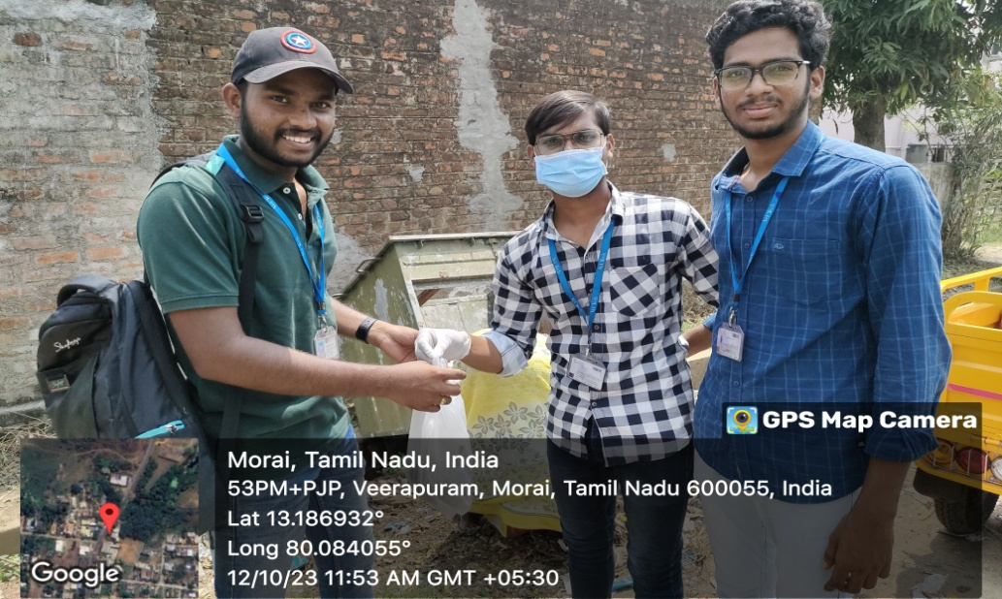
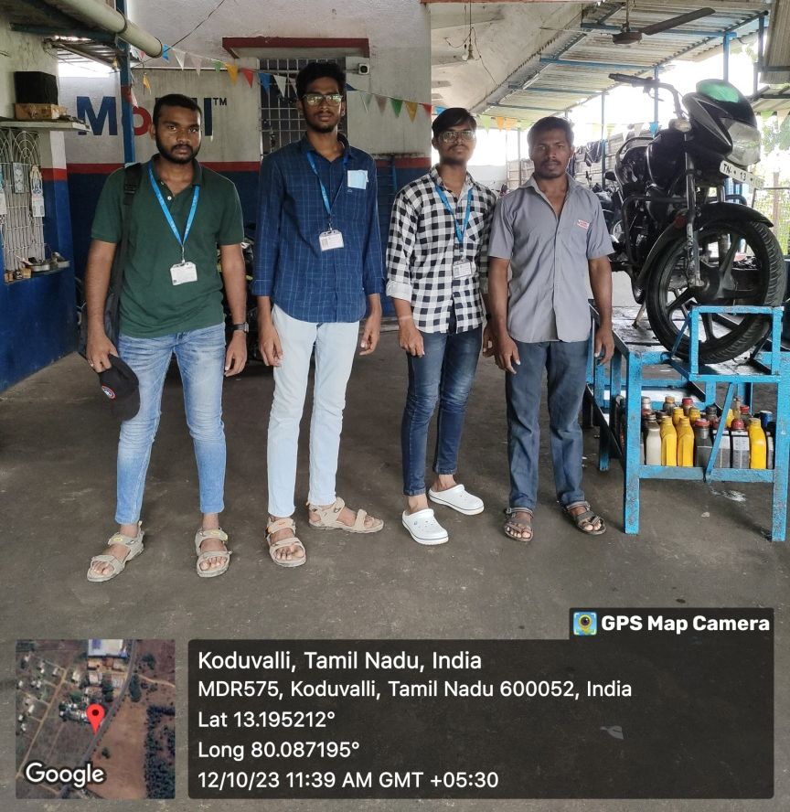
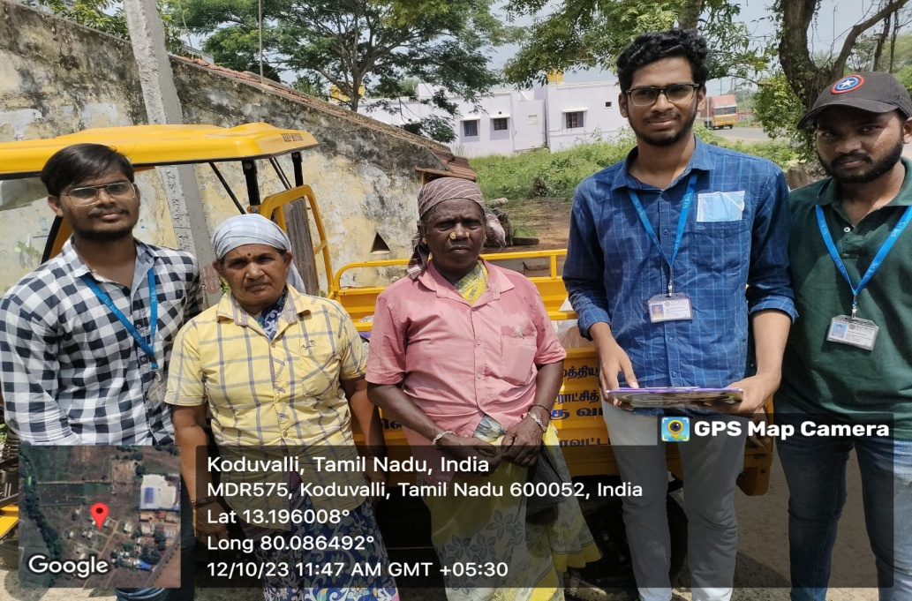
GEO TAGGED PHOTOS ,VIDEO LINK
BATCH NO:225 DEPARTMENT ELECTRONICS AND COMMUNICATION ENGINEERING

Slide 16
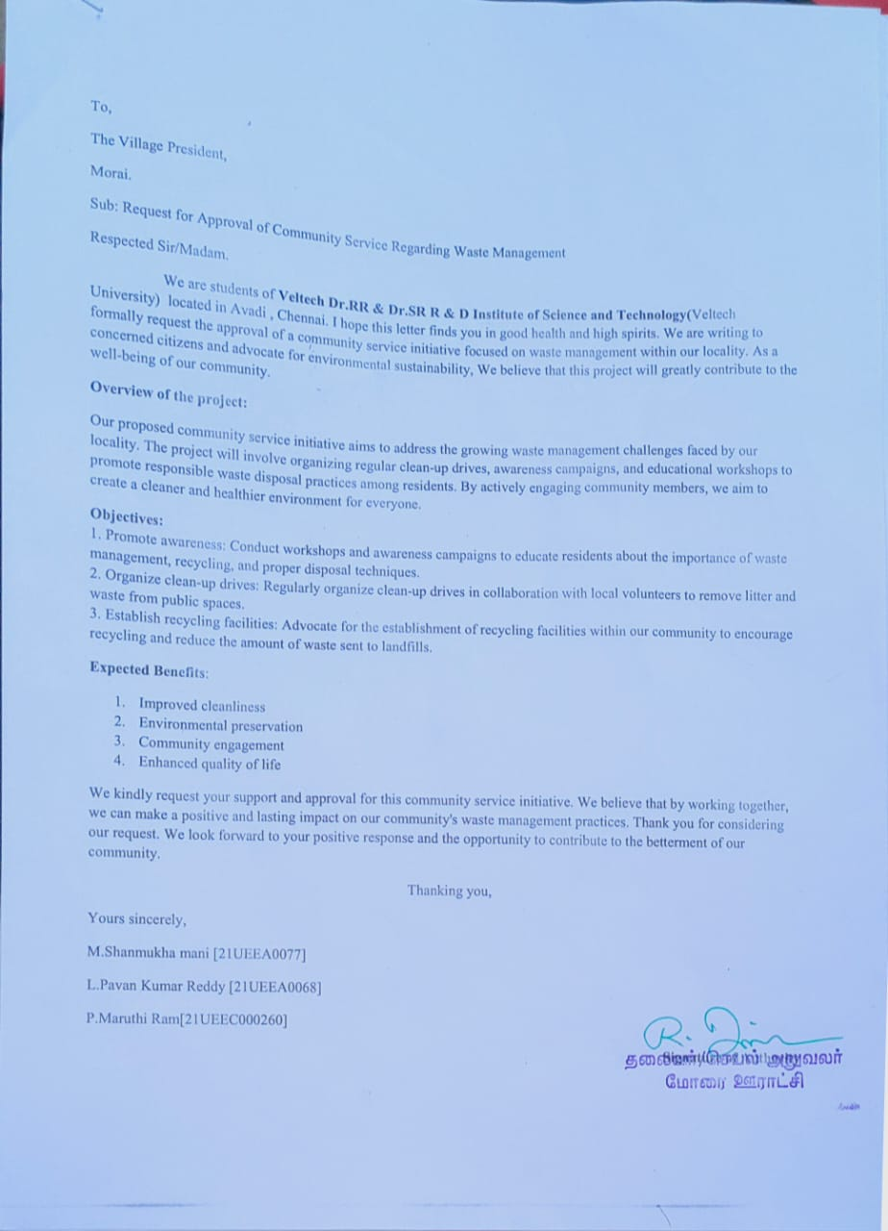
AUTHENTICATED SIGNATURES PROOF AND DETAIL.
BATCH NO: 225 DEPARTMENT ELECTRONICS AND COMMUNICATION ENGINEERING

Slide 17
RECOMMENDATIONS AND CONCLUSIONS OF THE COMMUNITY SERVICE PROJECT.
RECOMMENDATIONS
Introduce recycling bins in public places and organize regular pickups. Collaborate with local recycling centers to ensure collected materials are recycled properly.
Organize clean-up events and involve community members in cleaning public spaces.
Encourage participation through social media and local community groups.
CONCLUSIONS
The project successfully raised awareness about waste management practices, leading to a more informed community.
Collaborating with schools resulted in a decrease in single-use plastic consumption within the community.
BATCH NO: 225 DEPARTMENT ELECTRONICS AND COMMUNICATION ENGINEERING

Slide 18
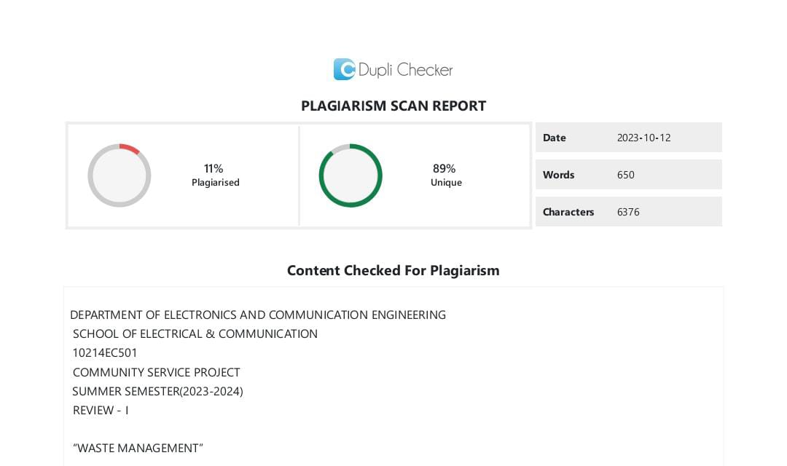
PLAGIARISM REPORT.
BATCH NO: 225 DEPARTMENT ELECTRONICS AND COMMUNICATION ENGINEERING

Slide 19
THANK YOU
BATCH NO: 225 DEPARTMENT ELECTRONICS AND COMMUNICATION ENGINEERING

